Slide 1
Prospective implementation of MiCA standards in Estonia
Mari-Liis Kukk, Ph.D.
Head of Innovation Department
29.09.2023

Slide 2
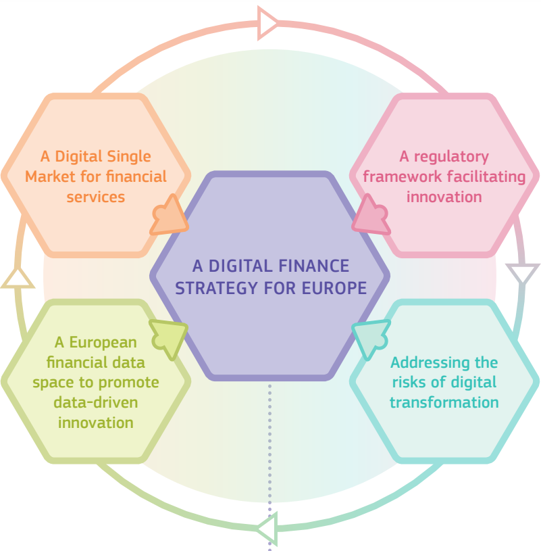
Digital Finance Package
September 2020;
License from one MS can be used to offer services in all others;
Harmonized rules for novel business models;
MiCA as first example;
Digital channels have special risks.
Notes:
Estonia is part of the EU, so financial sector rules are generally agreed on EU-level;
FinTech rules tend to be, and should be, even more harmonized;
Digital business models do not stick inside country borders;
EU Digital Finance Package September 2020, right after COVID pandemic
Once a company is established and licensed in one member state, it should be as easy as possible for that company to offer financial services in other Member States as well
Harmonized regulatory approaches of Member States, so there would be less barriers for companies to offer services across borders.
Necessary to address the new risks that arise when moving financial services to digital channels.
For instance concentration risk.

Slide 3
Crypto in Estonia before MiCA
One of the first countries to offer crypto business licenses (2017);
Only AML-CFT rules and issued by Financial Intelligence Unit (not FI);
No customer or investor protection mechanisms;
Too light touch;
Nearly 4000 licenses issued in first two years;
March 2020: First significantly stricter rules;
March 2022: Second significantly stricter rules;
September 2023: 79 valid licenses remaining.
Notes:
Estonia has a good example of how not to regulate digital businesses
Estonia was one of the first countries to start offering crypto business licenses at the end on 2017.
AML-CFT rules were the only thing that companies had to follow
The FIU did not have a lot of possibilities to say “no” to granting a license.
Estonian eResidency program made possible establishing crypto business in Estonia very easily.
Unfortunately, many of the companies getting licensed were rather shady businesses, operating frauds, scams or laundering money.
Rules started to get stricter. The first change in 2020 mainly brought in the requirement of actually having a physical presence in Estonia.
The second big change in 2022 was much stronger, with very high capital requirements put into place, quite similar to levels written down in MiCA, but also fit-and-proper evaluations for management and owners, evaluation of a business plan, IT-system evaluations.

Slide 4
MiCA timeline
Final text: available since April 2023;
Publication in EU official journal: 09 June 2023;
Application of stablecoin rules (Title III and IV): 30 June 2024;
Application of other MiCA rules: 30 December 2024;
Grandfathering up to 18 months after application date (1 July 2026);
Notes:
I will quickly remind everyone of the timeline intended on and EU level.
MiCA was officially published in June 2023, and the finalized version first made available a few months before that.
The two titles for stablecoins are intended to apply first, 12 months after the text is published in the official journal
The rest will take another 6 months to apply (December 2024).
Grandfathering could last up to 18 months after the enforcement date, full implementation could extend up to July 2026.

Slide 5
Estonian implementation plan
Crypto Asset Market Regulation: 21 August 2023 (first draft)
Some important proposals:
  Competent authority: FIU → Finantsinspektsioon;
  Also implements DORA, TfR for CASPs;
  CASPs may apply for license from 30 September 2024;
  Grandfathering cut very short: 1 July 2025;
  No simplified renewal procedure for authorization intended.
Notes:
First draft of the implementing Crypto Asset Market regulation for public consultations on August 21, 2023
Competent authority under MiCA will be Finantsinspektsioon
Also implements the EU Digital Operational Resilience Act and the Transfer of Funds Regulation for crypto-asset service providers
Ministry of Finance wants to allow CASPs to start submitting their applications early
Grandfathering of old licenses will come to and end early, so all CASPs previously licensed by FIU should by July 1, 2025 have acquired a new license under MiCA
No simplified renewal procedure established in the regulation,
Everyone would have to undergo the full authorization procedure instead.

Slide 6
Thank you!

