Slide 1
MiCAR:
Key concepts and impact on the current crypto market players
Akvilė Jurkaitytė, Associate
Vilnius
2023-09-29

Slide 2

Subject matter of MiCAR: Particulars
Transparency and disclosure for crypto-asset issuance and offering
Authorisation, supervision, operation etc. requirements of crypto-asset service providers and issuers
Crypto-asset holders’ protection requirements
Market abuse prevention measures

Slide 3


Key concepts
crypto assets:
  asset-referenced tokens;
  e-money tokens;
  other crypto-assets:
    - utility tokens.
distributed ledger technology (DLT)
crypto asset services & crypto asset service providers (CASPs)

Slide 4
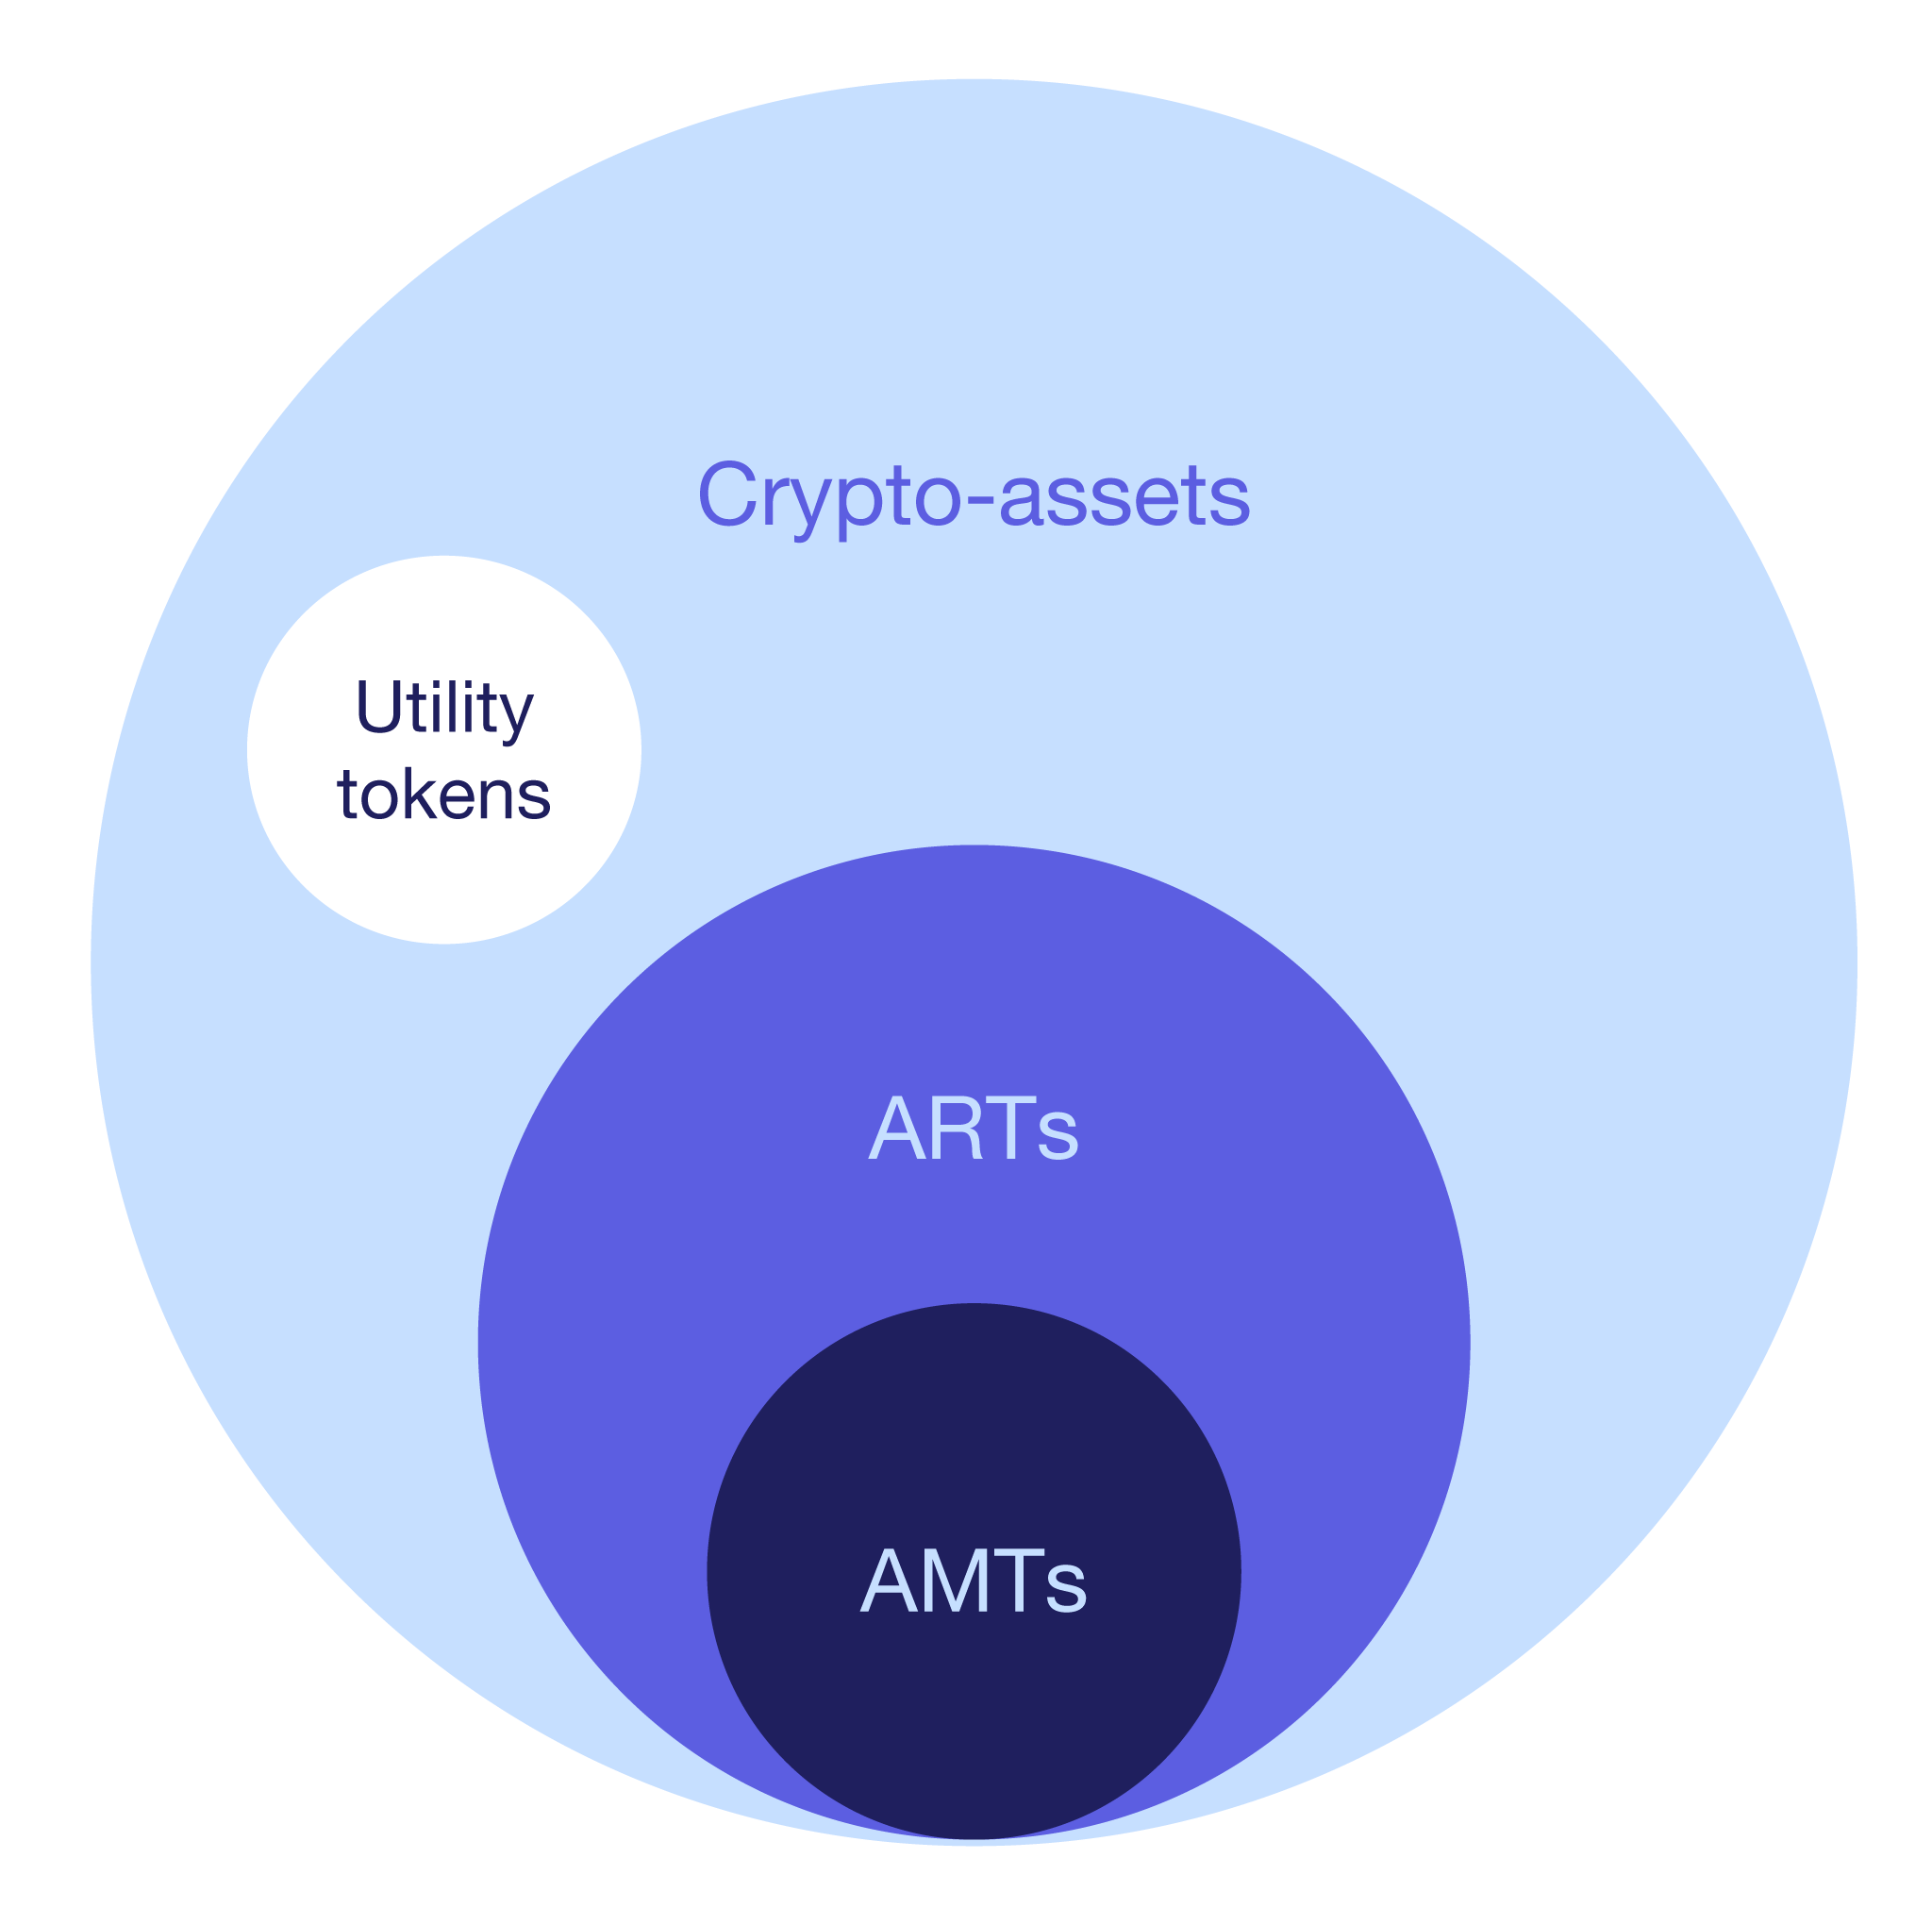
Key concepts:
Crypto-assets
  Crypto-assets:
  digital representation of value or rights
  which may be transferred and stored electronically,
  using DLT or similar technology
  Types:
  e-money token (EMT) – referring to a single official currency
  asset-referenced token (ART) – referring to several currencies or other
  all other – none of the above
    (i) utility tokens – crypto-asset that is only intended to provide access to the issuer’s good or service

Slide 5
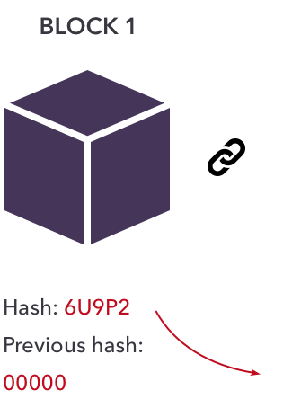
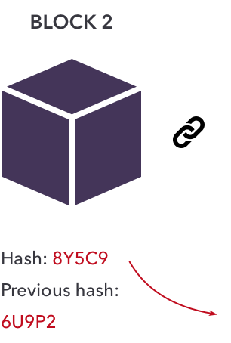
Key concepts:
(II) Technology & DLT
MiCAR is technology-neutral and does not regulate technology itself. Yet:
  distributed ledger – information repository that keeps records of transactions across a set of DLT network nodes
  distributed ledger technology (DLT) - a technology that enables the operation and use of distributed ledger
  consensus mechanism – the rules by which a transaction is validated

Slide 6

Key concepts & definitions:
(III) Services and providers
crypto asset services – any of the following services involving crypto-assets:
  custody and administration
  operation of a trading platform
  exchange services fiat-to-crypto
  exchange services crypto-to-crypto
  execution of orders
  placing
  reception and transmission of orders
  providing advice
  portfolio management
  transfer services

Slide 7
Key concepts & definitions:
(III) Services and providers
crypto asset service provider (CASP) – a person authorised to provide any of the above services on a professional basis

Slide 8

Excluded from scope
Decentralised finance (DeFi)
Central bank digital currencies
Crypto-assets that are unique and not fungible with other crypto-assets (e.g. NFTs)
Crypto assets that do not have any identifiable issuer (limited applicability)

Slide 9

Conduct of business
Complaints-handling procedures
Confict of Interest procedures
Reserve of Assets
Safekeeping of clients‘ crypto assets and funds
Other policies and procedures depending on the services

Slide 10
Market abuse and integrity
Unlawful disclosure of inside information
Insider trading
Actions that are likely to lead to disruption or manipulation of crypto-assets

Slide 11
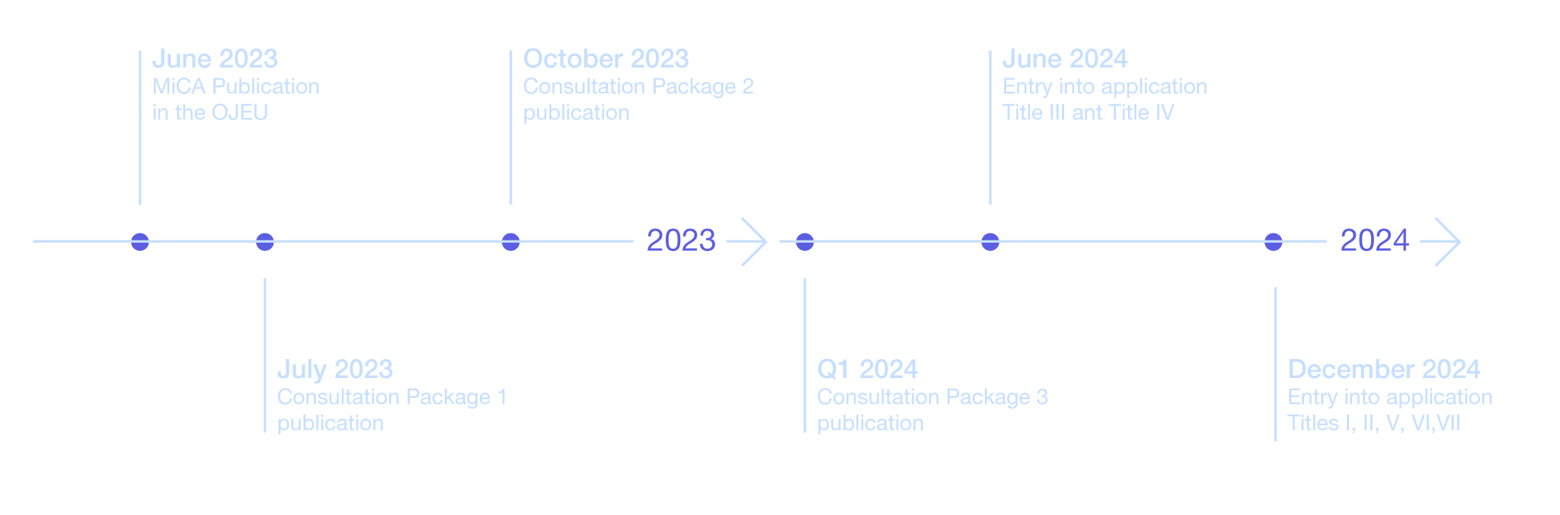
Source: ESMA
Timeline
Market in Crypto-Assets Regulation (MiCA)
Implementation timline

Slide 12
Other regulations to observe
A complete Anti-Money Laundering package (AMLD 6, Transfer of Funds Regulation, New regulation on AML CFT (Proposal for a Regulation of the European Parliament and of the Council on the prevention of the use of the financial system for the purposes of money laundering or terrorist financing and Proposal for a Directive of the European Parliament and of the Council on the mechanisms to be put in place by the Member States for the prevention of the use of the financial system for the purposes of money laundering or terrorist financing and repealing Directive (EU) 2015/849)
DLT Pilot Regime
Digital Operational Resilience Act (DORA)
Tax transparency rules for crypto-asset transactions (DAC8)

Slide 13

Impact to current crypto market players
Authorisation – somewhat similar to MiFID II?
Financial service
Passporting to EU

Slide 14
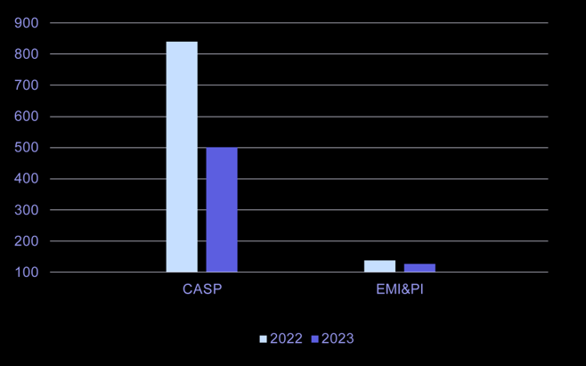
Crypto-asset service providers (CASP) vs. Electronic money institutions (EMI) and Payment institutions (PI) in Lithuania

