Slide 1
MiCA and the role of ESMA
Elena Brannetti, Senior Legal Officer, ESMA

Slide 2
Table of Contents
Before MiCA
MiCA – entry into application
MiCA – types of crypto-assets
MiCA – issuers of crypto-assets
MiCA – crypto-asset service providers
MiCA – provisions on market abuse
MiCA – the role of ESMA: (i) technical standards
MiCA – the role of ESMA: (ii) guidelines
MiCA – further roles for ESMA

Slide 3
Before MiCA
No EU-harmonized discipline on crypto-assets and related services
ESMA issued several warnings on risks of crypto-assets*, including:
  Extreme price movements
  Misleading information
  Absence of protection
  Product complexity
  Risk of fraud and market manipulation
  Hacks, operational risks and security issues
Technical advice to the Commission on initial coin offerings and crypto-assets**
* esa_2022_15_joint_esas_warning_on_crypto-assets.pdf (europa.eu)
* ESMA sees high risk for investors in non-regulated crypto assets (europa.eu)
** esma50-157-1391_crypto_advice.pdf (europa.eu)

Slide 4
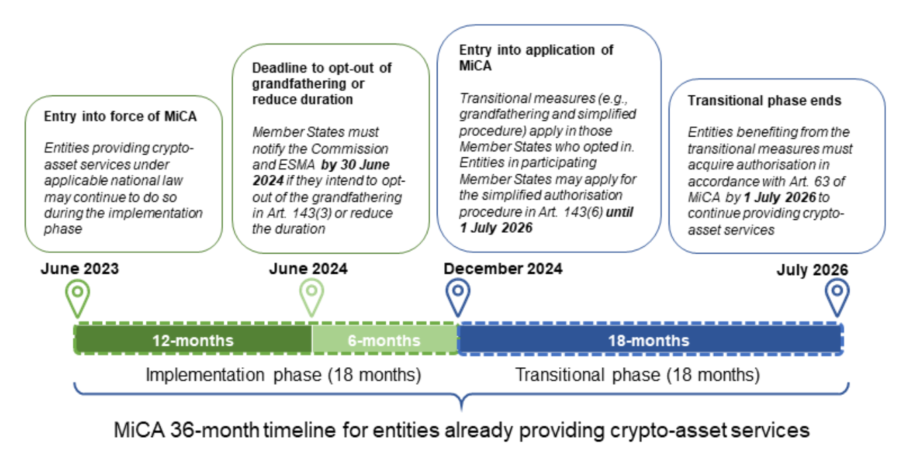
MiCA – entry into application

Slide 5
MiCA – types of crypto-assets
Crypto-assets
Asset-referenced tokens
A type of crypto-asset that purports to maintain a stable value by referencing to the value of one official currency
A digital representation of a value or a right which may be transferred and stored electronically, using distributed ledger technology or similar technology
a type of crypto-asset that is not an electronic money token and that purports to maintain a stable value by referencing to any other value or right or a combination thereof, including one or more official currencies
E-money tokens

Slide 6
MiCA – issuers of crypto-assets
Issuers of crypto assets other than ART or EMT
  Offers to the public, admission to trading – no registration required
  White paper notified to the national competent authority
  Marketing communication
  General obligations
Issuers of asset-referenced tokens (ART)
  Application for authorisation
  White paper approved by national competent authority and marketing communication
  Specific obligations and requirements (own funds, reserves of assets, rights of ARTs holders)
  Significant ARTs - Specific additional obligations arriving from the systemic nature of the crypto asset
Issuers of electronic money tokens (EMT)
  White paper (notified to national competent authority), marketing communication
  Specific obligations and requirements (issuers are credit institutions and electronic money institutions)
  Significant EMTs - Specific additional obligations arriving from the systemic nature of the crypto asset

Slide 7
MiCA – crypto-asset service providers
Crypto-Asset Service providers (CASP)​
Application and Authorisation​
General obligations​
Specific obligations​ - depending on the crypto-asset services provided
Significant Crypto-Asset Service Provider (sCASP)​
​‘crypto-asset service’ means any of the following services and activities relating to any crypto-asset:
  (a) providing custody and administration of crypto-assets on behalf of clients;
  (b) operation of a trading platform for crypto-assets;
  (c) exchange of crypto-assets for funds;
  (d) exchange of crypto-assets for other crypto-assets;
  (e) execution of orders for crypto-assets on behalf of clients;
  (f) placing of crypto-assets;
  (g) reception and transmission of orders for crypto-assets on behalf of clients;
  (h) providing advice on crypto-assets;
  (i) providing portfolio management on crypto-assets;
  (j) providing transfer services for crypto-assets on behalf of clients;

Slide 8
MiCA – provisions on market abuse
Prohibition of market manipulation
Prohibition of selective disclosure
Prohibition of insider dealing
Definition of inside information
MiCA
Cooperation between NCAs, ESMA and EBA
Public disclosure of inside information
Prevention and detection of market abuse
Powers of Competent Authorities

Slide 9
MiCA – the role of ESMA: (i) technical standards
What are the technical standards? Difference between draft RTS and ITS
ESMA is currently working to deliver the following draft technical standards:
  Article 60(13): draft RTS on content of notification from selected entities to national competent authorities (NCAs) to provide crypto-asset services
  Article 60(14): draft ITS on forms and templates for notification from entities to NCAs to provide crypto-asset services
  Article 62(5): draft RTS on the content of the application for authorisation for CASPs
  Article 62(6): draft ITS on forms and templates for CASP authorisation application
  Article 71(5): draft RTS on complaint handling procedure
  Article 72(5): draft RTS on management and prevention, disclosure of conflict of interest
  Article 84(4): draft RTS on intended acquisition information requirements
  Articles 6(12), 19(11), 51(15), 66(6): draft RTS on Sustainability indicators
  Article 68(10)(a): draft RTS on Business continuity requirements
  Article 76(16): draft RTS on Trade transparency data and order book record-keeping
  Article 68(10)(b): draft RTS on Record keeping requirements for CASPs
  Article 109(8): draft RTS on Classification and templates and format of crypto-asset white papers
  Article 88(4): draft ITS on Public disclosure of inside information
  Articles 6(11), 19(10), 51(9): draft ITS on standard forms, formats and templates for white papers
  Articles 95, 96, 107: draft RTS and ITS on cooperation

Slide 10
MiCA – the role of ESMA: (ii) guidelines
What are guidelines? Comply or explain mechanism for national competent authorities, relevant provisions of Article 16 of the ESMA Regulation
ESMA is currently working to deliver the following sets of guidelines:
  Articles 21(3) and 63(11): Suitability of members of management body and holders of qualifying holdings of CASPs and of issuers of ARTs
  Article 2(5): Qualification of crypto-assets as financial instruments
  Article 92(3): Monitoring, detection, and notification of market abuse
  Investor protection:
    Article 61(3): Reverse solicitation
    Article 81(15): Suitability of advice and portfolio management services to the client
    Article 82(2): Policies and procedures for crypto-asset transfer services, including clients' rights
  Article 14(1): System resilience and security access protocols
  Article 97(1): qualifications of crypto-assets

Slide 11
MiCA – further roles for ESMA
ESMA temporary intervention powers
Opinions on classification of crypto-assets (Article 97(3))
Coordination role of national competent authorities (for specific measures, investigations etc.)
Maintaining registers and databases (white papers, CASPs, non-compliant entities)

Slide 12
Any questions?

